Slide 1
Progress Demonstration
GlidingTeam
Andrew Brown, Connor Crabb-Thompson, Jeremy May, Mark Campbell

Slide 2
Introduction
Build a glider that can deliver vital supplies to people in need when they are in hard to reach locations
Notes:
Jeremy

Slide 3
Project Goals
Folding Wings
Glide Ratio of 6:1 (Ratio between horizontal and vertical distance at constant speed)
Compact Design
Lightweight
Affordable
Active steering and stabilisation
Some form of localisation method
Notes:
Jeremy

Slide 4
Requirements of glider
Spread wings when dropped or thrown
Achieve active stabilised gliding
Carry and deliver a payload of approximately 50g (an egg)
Object Avoidance
Controlled Landing
Notes:
Jeremy

Slide 5
Subjects covered from labs
CAD (Autodesk Fusion 360)
CAM (3D Printing)
Finite Element Analysis (FEA)
Tensile/Hardness Testing
Soft Mechanisms and Materials
Agonist-Antagonist Joints
Notes:
Jeremy

Slide 6
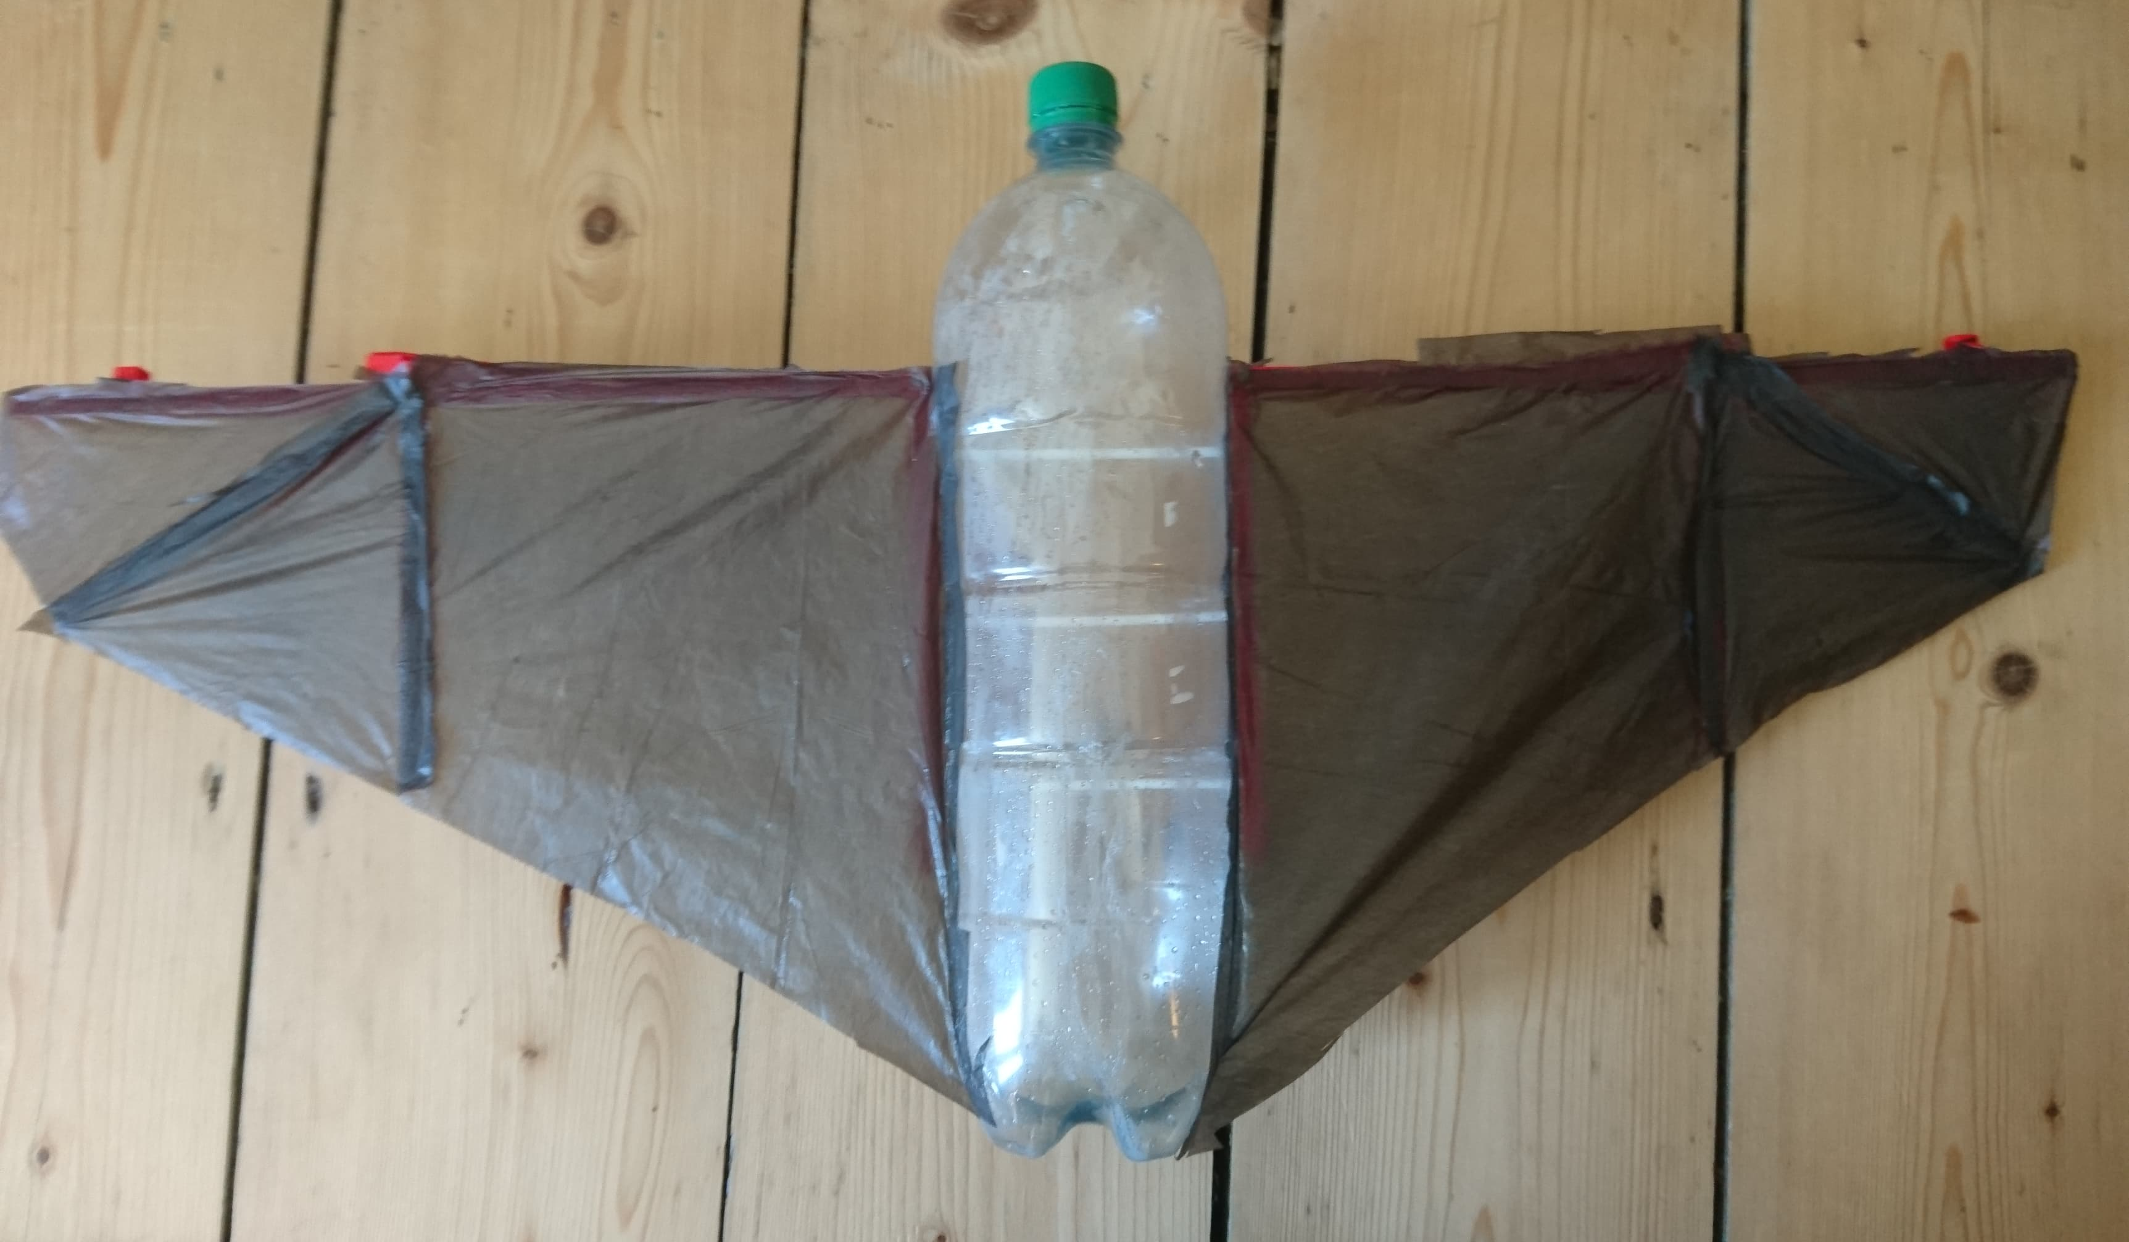
Initial Design – The Bin Bag Bat
Purpose
Understand the task of gliding
Fold wings like a bat
Cheap, lightweight materials
Lessons Learned
Weight distribution needs attention
The wings are fragile
Not aerodynamic
No stabilising tail
Wings not efficiently designed for flight
Glide Ratio 1:1 on average
Notes:
Mark

Slide 7
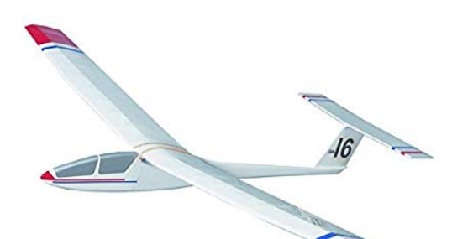
Purchase a glider?
Investigated various options
~£30 → £70
Decision to design our own using the input from hobbyists online.
Further Research into:
Typical designs
Fuselage
Wings
Tail
Typical materials
Weight Distribution
Notes:
Connor

Slide 8
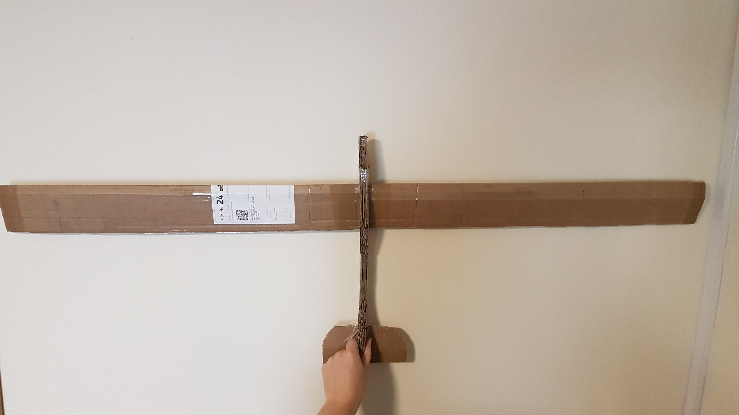
Secondary Design
Fixed wing design with proven airofoil HS130 Design
Lightweight, Low cost material (cardboard)
Wings do not fold
Weight distribution is an important consideration
Basic tail for stabilisation
Wing span approx. 1.2 meter (tip to tip)
Notes:
Connor

Slide 9
Secondary Design Conclusion
What we learned:
Tail vital to proper stabilisation
Tail mounting distance is proportional to steering sensitivity
Wing span adds to stabilisation
Weight distribution is key
A proper aerofoil profile adds to efficiency and stabilisation
Lighter materials such as SolarFilm and PLA can be used
Glide Ratio of 2:1 on average
Notes:
Connor

Slide 10
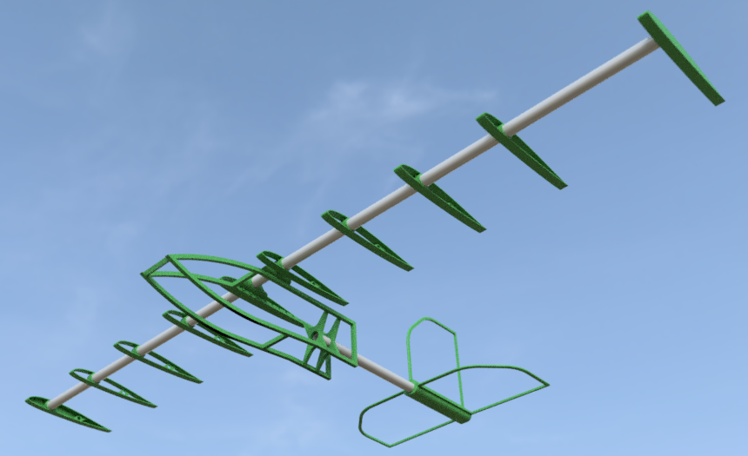
Tertiary Design
Design uses CAD made models
Design involves a skeleton structure
Light weight
Wings wrapped in a light weight shrink wrap (Solar Film)
Easier to develop into a soft robot
Fuselage space for electronics
Change in wing size making them deeper and shorter
Large tail fins
Notes:
Andrew

Slide 11
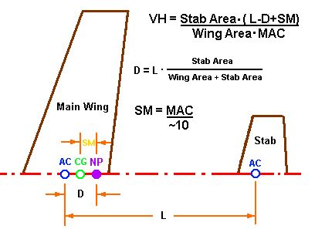
Calculations
Finding the AC (Aerodynamic Centre) – where the aerodynamic forces act on the wing
Finding NP (Neutral Point) – Where the aerodynamic forces act on the plane
Finding CoG (Centre of Gravity)
Finding HV (Horizontal Tail Volumes)
Finding VV (Vertical Tail Volumes)
Finding CWL (Cubic Wing Load)
Notes:
Andrew

Slide 12
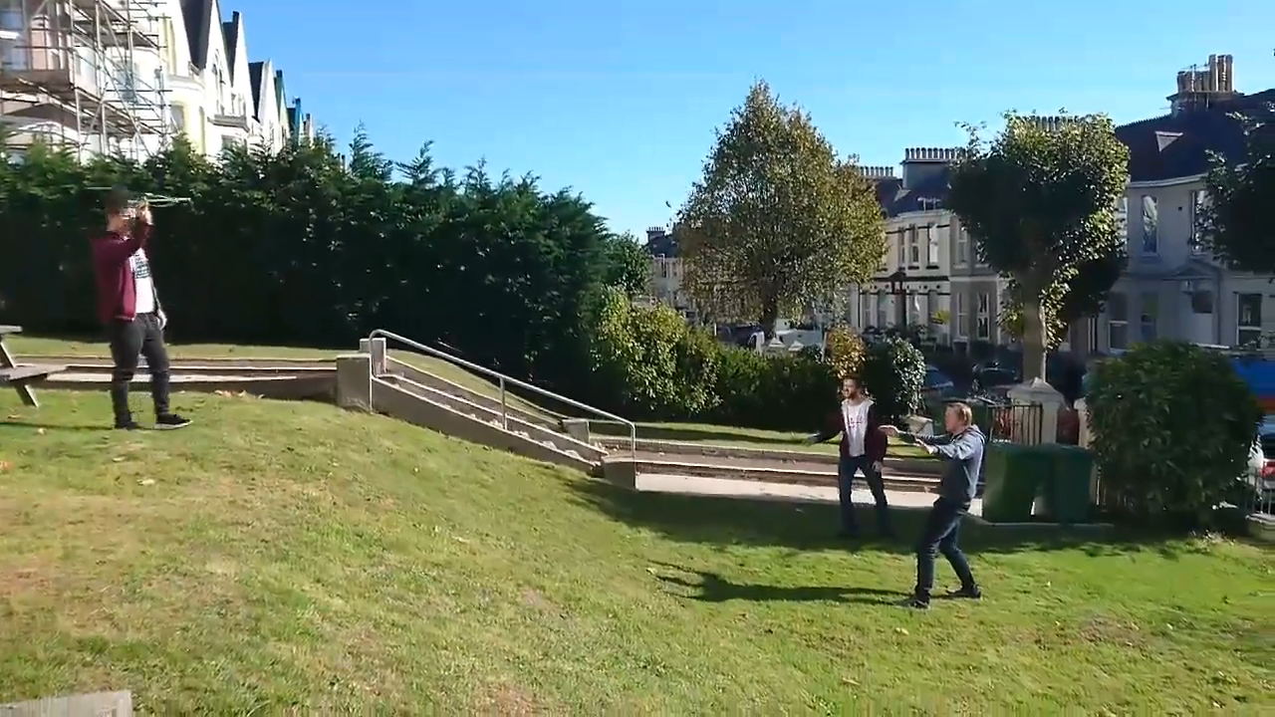
Testing Tertiary Design

Slide 13
Tertiary Design Conclusion
Too Back Heavy causes stall
Re-design of tail will make it lighter and will be designed to utilise the servo control.
Glide Ratio of 4:1 on average

Slide 14
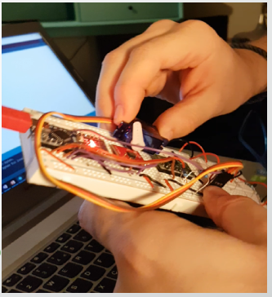
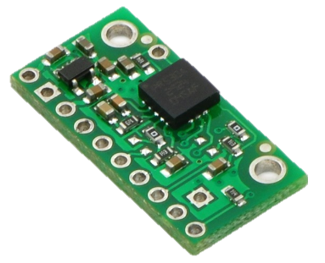
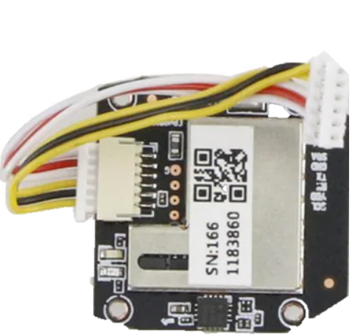
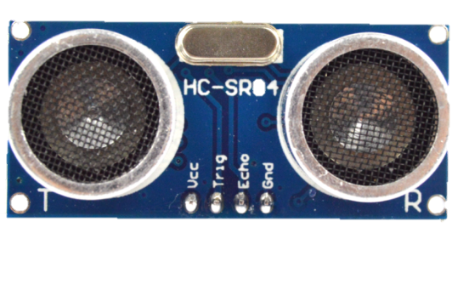
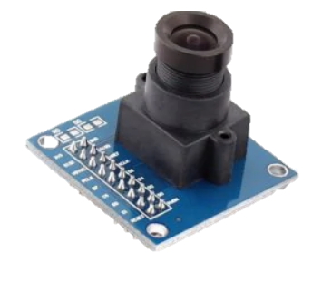
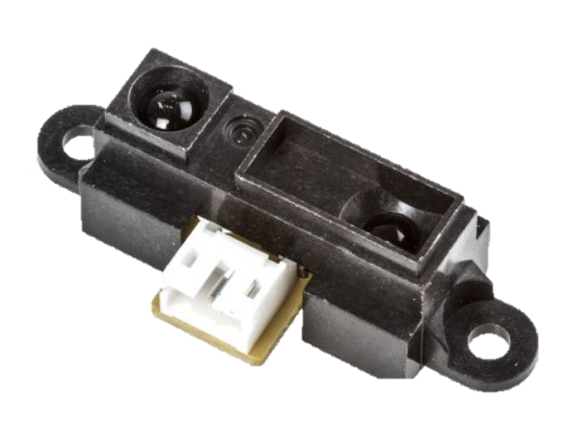
Electrical Progress
Investigated Gyroscope
Servo reacts to Accelerometer data
Servo reacts intelligently to Accelerometer data
When fall detected adjust angle
Adjust servo with respect to gravity
Shortly to be looking into:
Gyroscope - LPR550AL
GPS - JJRC GPS Positioning Module
Distance Sensor
Ultrasound - HC-SR04
Infrared - GP2Y0A41SK0F Sharp, Reflective Sensor
Camera - OV7670 300KP VGA Camera
Notes:
Connor

Slide 15
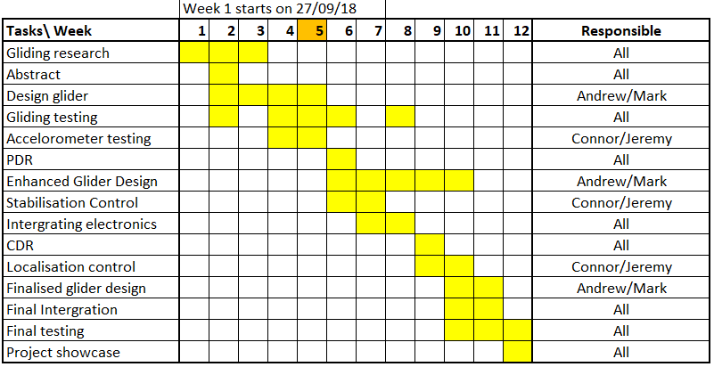
Plan
Notes:
Connor

Slide 16
Further Development
Stable gliding
Balancing the glider
Servos control rudders based off of accelerometer data
Controlled landing
Detect distance from ground
Stall flight to slow quickly
Land smoothly and slowly
Autonomous steering toward target location
Notes:
Jeremy

Slide 17
Glider mechanical improvement
Cut the wings in half
Wings use agonist and antagonist system that needs implanting
Develop active tail steering pivoting
Weight issues to address
Integrated electronics for even weight distribution
Ninja flex integration along with stretch wrap
Notes:
Andrew

Slide 18
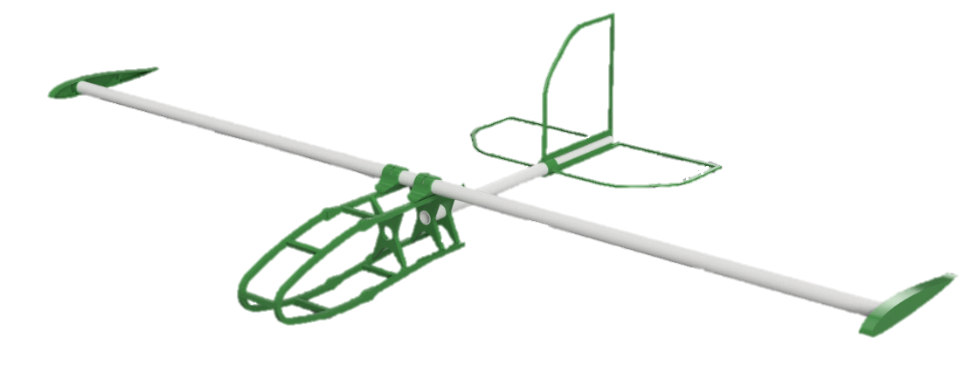
Design 3.1

Slide 19
Questions?

